Slide 1

Project 4
Predicting the Housing Market in California

Slide 2

Introduction
The project aims to develop a housing model tool to predict median house values in California. We aim to investigate the correlation between median household income and the number of rooms in living spaces. Additionally, we seek to analyse the relationship between median household income and house pricing, as well as the correlation between median household income and median house prices.

Slide 3

Part 1: Exploration and preprocessing of the data - Experimenting different learning models

Slide 4
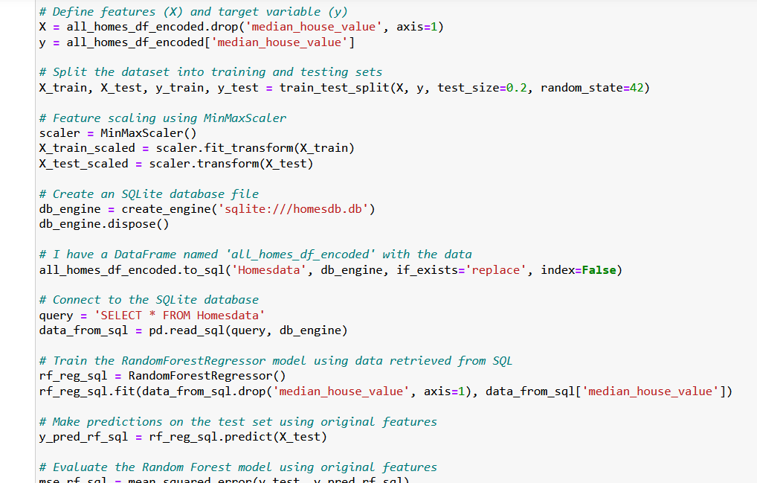
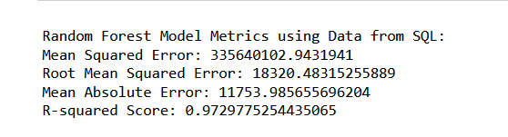
Our project starts with the implementation of the data to make it ready to use on the learning models.
To do so we used the Python Pandas library as well as the Matplotlib to explore the initial dataset.
In addition, we used SciPy to calculate the z-scores and linear regression, providing valuable insights into data distribution and outliers.
We conducted our initial testing phase using Scikit-Learn, to assess the performance of our models.

Slide 5

Part 2: Model implementation and analysis

Slide 6
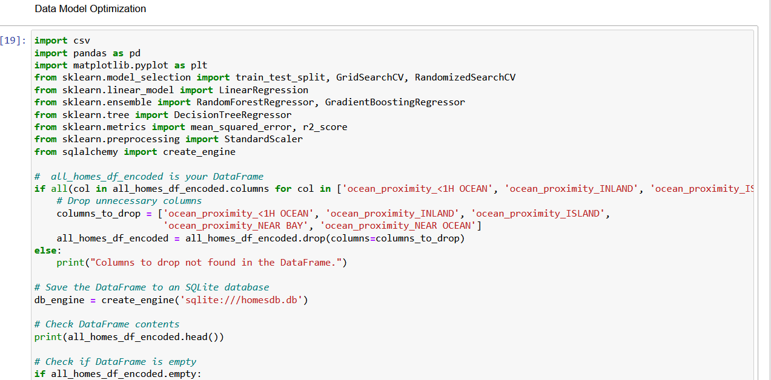
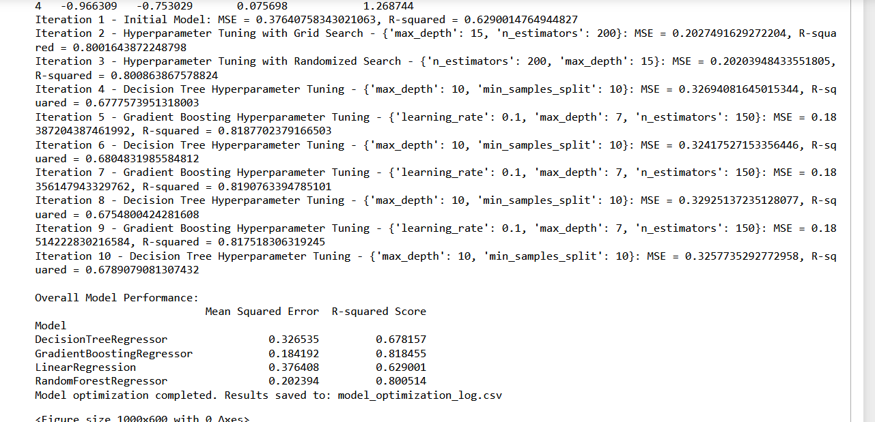

Slide 7

Part 3: Visualization of the dataset

Slide 8

In this part, we crafted two narratives using Tableau. The first story provides insightful visualizations extracted from the initial dataset, offering a comprehensive understanding of the underlying patterns and trends.
The second story centers around the predicted values generated by our optimized learning model, showcasing the real-world application of our machine learning insights.
https://public.tableau.com/app/profile/gwendoline.grenu/viz/Project4-CaliforniaHousing/Story1#1

Slide 9
Conclusion
It was a very challenging process we had difficulties to start with because we were using the scaled data which came back with a very low R-score of about 70% we were able to overcome this by switching to the unscaled data. We also applied different machine learning models to allow for better analysis.
Generally high R-squared score values were returned suggesting that a significant portion of the target variable's variability was captured by the model. Mean Squared Error, Root Mean Squared Error, Mean Absolute Error were all low suggesting little error in the prediction.

